Slide 1

How To Use JUnit To Conduct Automatic Testing?
Global Technology China
By Kenneth Liu (from Workflow, Domino & Document Mgt.)

Slide 2
The Benefit of Automatic Testing
Manual testing takes time. It’s boring and tiresome.
Testing is repeatable – so why not save the time
Avoid mistakes
The foundation for regression testing
With the continuous integration, it can result in “invest once, benefit all the time!”
Improve programmer's development habits and interest
It’s a great feeling to see that “green light” indicating everything passed after some heavy development!

Slide 3
How To Use JUnit
The principle: Given an input (test data), compare the expected output and actual output of target program with assert statements
JUnit 3/4 is a built-in package in Eclipse/WSAD/RAD
  You can use it directly in Eclipse/WSAD/RAD
Create your test case class by extending junit.framework.TestCase

Slide 4
How To Use JUnit (cont.)
Create test methods with names beginning with the word “test”. Each test method is independent. No dependency should exist among test methods. When the test class runs, all test methods will be invoked automatically.
  public void testXXX() {}
Use setUp method prepare the common required resources for testing. Use tearDown method to release the resources or housekeep the temporary test data.
    The run sequence is setUp() -> testXXX1() -> tearDown() -> setUp() -> testXXX2() -> tearDown() ...

Slide 5
How To Use JUnit (cont.)
Use assert statements to verify the result.
    assertEquals(String failedDesc, Object expected, Object actual)
    assertFalse(String failedDesc, boolean target)
    assertTrue(String failedDesc, boolean target)
    assertSame(String failedDesc, Object obj1, Object obj2)
    assertNotSame(String failedDesc, Object obj1, Object obj2)
    assertNull(String failedDesc, Object obj)
    assertNotNull(String failedDesc, Object obj)
    fail(String failedDesc)

Slide 6
How To Use JUnit (Cont.)
Use TestSuite to integrate the TestCases.
suite method can also be used to specify which test method to be invoked when the test case is run. For such case, you must add a constructor with method name.
    Public SampleTest(String methodName) {
    super(methodName);
    }
All test cases can be integrated in a project test suite for integration test and regression test.
Test cases for a module MUST be 100% passed. All test cases in the project test suite MUST be 100% passed before delivering.

Slide 7
Example
/**
* Test add method.
*/
public void testAdd() {
int a = 1;
int b = 2;
int c = 3;
Calculator cal = new Calculator();
assertEquals("The add result is not correct!", c, cal.add(a, b));
}

Slide 8
Example (cont.)
/**
* Add 2 integers
*
* @param a The given integer 1
* @param b The given integer 2
* @return The result
*/
public int add(int a, int b) {
return a + b;
}

Slide 9
The Naming Convension of Test Cases
Treat the test class as the document of test plan. Write the test strategy, test steps and expected result in Javadoc/comments to ensure the reader can read it like a document
Name the test class, test method with descriptive words Long class name or long method names are preferred
Test Class: Test[target_class]_[desc]. Ex: TestRobot_HealthCheck
Test Method: test[target_method]_[desc]. Ex: testProcess_AddNewForm
Test Suite: [desc]TestAll. Ex: ProjectTestAll

Slide 10
Best Practices
Same package, different source folders
    src/main/java
    src/main/resources
    src/test/java
    src/test/resources
Create mock classes to extend the target class and override the target methods for testing. Set the methods and fields as protected in the target program as many as possible.
Mock
  E.g. Mock Data Access Objects (DAOs)
Web applications – MVC model
The most important thing is to prepare a high-quality and high coverage test cases.
Test cases should be reviewed by more experienced colleagues or peer.

Slide 11
Test Driven Development (TDD)
Before writing the code or changing the code, write the test cases first.
Failed -> Passed -> Refactoring
Small steps. Limit the scope of each step to keep the simplicity.
Writing test cases is also the step of designing.
TDD can improve the code quality

Slide 12
2 Principles of TDD
Small Steps
Failed -> Passed -> Refactoring

Slide 13
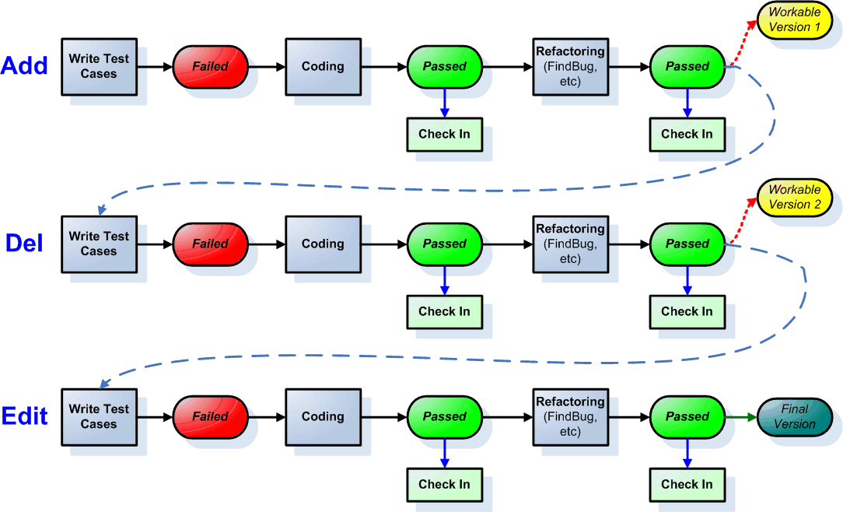
2 Principles of TDD (cont.)

Slide 14
The Limitation of JUnit
JUnit is applicable for J2SE only (there are extending frameworks, say HttpUnit, Cactus, JSUnit, etc, for J2EE or other containers).
JUnit focus on unit test. Not all testing can be automatic. SAT/UAT/Stress Test are still required.

Slide 15
xUnit
JUnit (Java)
NUnit (.NET)
CppUnit (C++)
DUnit (Delphi)
PHPUnit (PHP)
…

Slide 16
Conclusions
Automatic testing is a good way to improve the quality and productivity.
Automatic testing can not replace all types of testings
Automatic testing is insufficient but necessary conditions. So try to use automatic testing as much as possible. Manual testing is still required for the areas which are not applicable for automatic testing.
Automatic testing is the foundation of agile development because it provides rapid feedback.

Slide 17
References
eCampus:
  Best Practices in Test Driven Development (en_US_16349_ng)
Books:
  JUnit In Action (by Vincent Massol with Ted Husted)
  Test Driven Development By Example (by Kent Beck)
  Beautiful Code (by Greg Wilson)
  Clean Code (by Robert C. Martin)
Websites:
  http://tech.it168.com/zt/Junit/index.html
  http://www.infoq.com
  http://www.ibm.com/developerworks/cn/java/
Google search key words:
  “junit”, “tdd”, “测试驱动编程”

Slide 18
Feedback / Q&A
What’s your feeling about this topic?
What’s your deepest impression?
Do you think it’s helpful?
Any questions?

